Slide 1
Sociomateriality of Education Policy
Paolo Landri
IRPPS-CNR
SUSEES - Summer School in Sociologies of Education
University of Napoli ‘Federico II’
Second Edition
p.landri@irpps.cnr.it

Slide 2
Act 1
Starting in the ‘middle of things’

Slide 3
Research: The Fabrication of the Conferences of Zone of the Provincia di Napoli
At the end of ‘90s, the reform of state in Italy redesigns the education policy space: a) by promoting policies of deconcentration (within the state) through the development of autonomous schools and the shift of responsibilities to some peripheral offices of the Ministry; and b) by trying the implementation of policies of decentralization (from the state to local authorities) where Regione, Provincia and Comune had increasing and complementary roles in the field of education policy-making
In particular, ‘Provincia’ is asked to coordinate educational provision of Comune (the Municipalities - responsible for compulsory schooling), and to design the ‘right’ mix of upper secondary schools with respect to educational needs. National regulations envisage that Provincia may devise education participatory policy spaces, called literally ‘functional zones for the improvement of the educational provision’ (Legislative Decree 112/98 and 267/2000), to carry out these responsibilities.

Slide 4
Research:
A long research programme (2004-2009) that included: a) a research project on school buildings and facilities in support of the elaboration of a new plan for the use of school buildings (with the Department of Sociology and the Second University of Napoli) b) a research project on the enactment of the functional zones for the improvement of the educational provision (with Department of Sociology), and c) a project on early school leaving (called SPES_GOAL) that envisaged the collaboration of Department of Sociology, IRPPS-CNR, ISFOL, University of Napoli ‘Suor Orsola Benincasa’, USR –Campania (The Peripheral Office of the Ministry of Education, University and Research).

Slide 5
LITERATURE
Mol, A., & Law, J. (1994). Regions, Networks and Fluids: Anaemia and Social Topology. Social Studies of Science, 24(4), 641–671.
Latour, B. (2005). Reassembling the Social. An introduction to Actor-Network Theory (p. 300). Oxford: Oxford University Press.
Sørensen, E. (2009). The Materiality of Learning. Technology And Knowledge Educational Practice. Cambridge MA.
Fenwick, T., & Edwards, R. (2010). Actor-Network Theory and Education. London: Routledge.

Slide 6
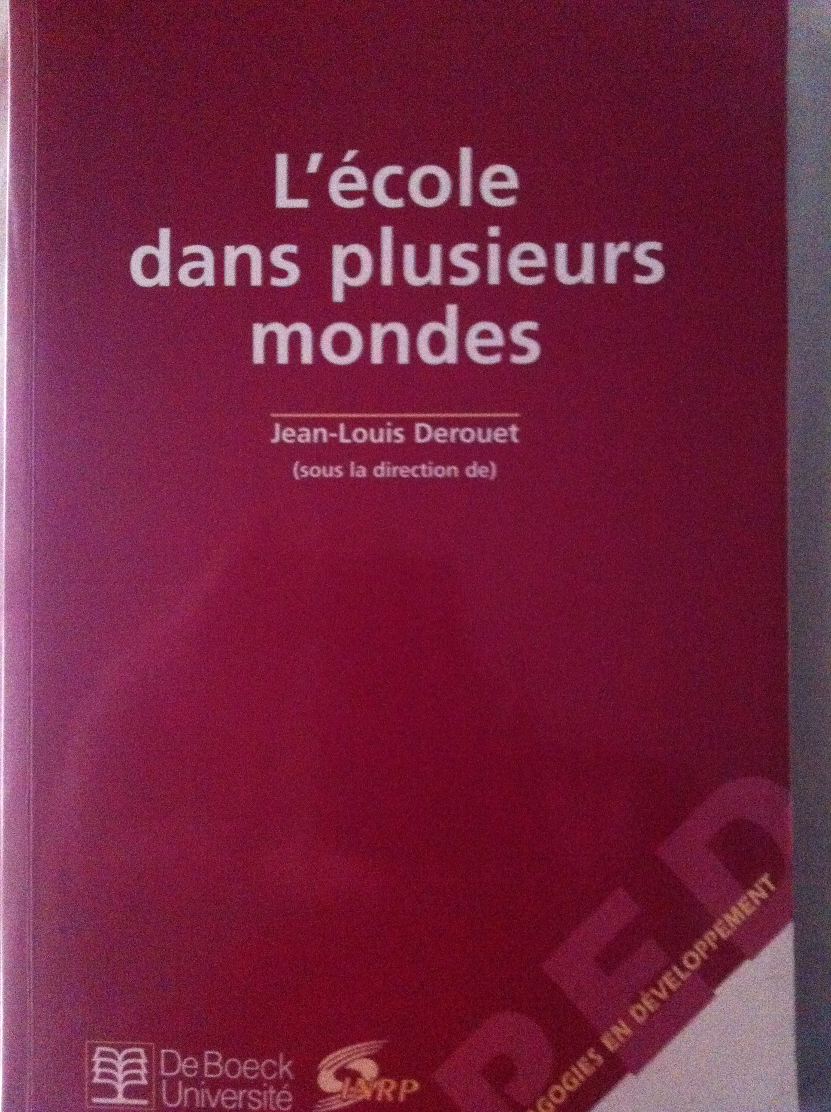
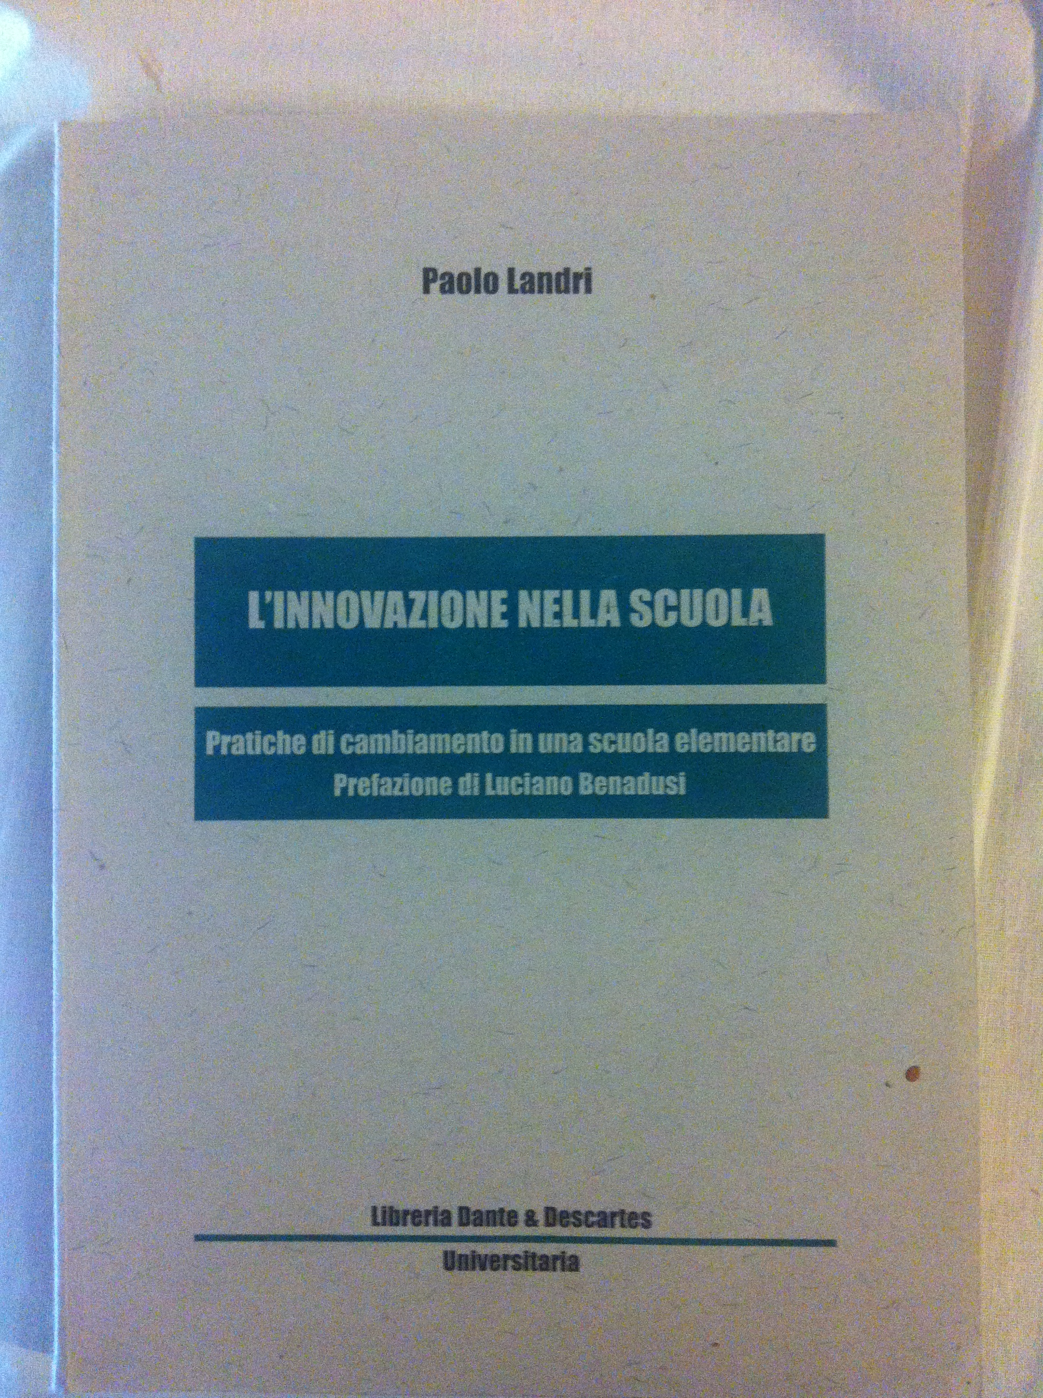
Excursus 1: How I contributeD to the circulation of ANT IN ITALY
1996
2000
2000
2000

Slide 7
Research: Methodology
Research Questions:
1) How does an education policy making space materialises in practice ?
2) Is there a single, or are there multiple instantiations of education policy making space ?
Data: a) interviews to the staff management of the Department of Instructional Planning (10), and to the Councillor of Education of the Provincia di Napoli (2); b) transcriptions of the Conferences of Zone from 2004 to 2007 (14); c) ethnographical notes of their everyday working practices of Department of Instructional Planning (10 days); d) interviews to 8 headteachers of two selected educational zones (a zone with and a zone without a consolidate experience of networks of school), and the notes taken ethnographically while participating at the Conferences of the selected zones as reported in Grimaldi’s investigation (Grimaldi, 2010); e) deliberations and plans of the Provincia of Napoli concerning the activation and the decision of the Conferences of the Zones

Slide 8
Research: Methodology
Network Ethnography: researcher/s followed/s the actor/s (human and nonhuman), and their associations over time, and tried to develop a theoretically informed understanding of what they have described, or what the actor/s said about interactions in which they have been involved
Data Analysis: A socio-technical analysis leads to a topological reading that focuses on the ‘doings’ of the policy space, i.e. on what actors do, on the associations they make, on the assemblages of humans and the nonhuman with which they align, and on the work to hold these assemblages on line (Ceulemans, Simons, & Struyf, 2014)

Slide 9
Act 2
First Response: Education Policy Making Space as Assemblage of Humans and Nonhumans

Slide 10
Response 1
The fabrication of a new space of education policy requires a delicate socio-technical composition: initial intentionality, an association of texts (national and local), a mix of knowledges (scientific and professional), the production of data, the visualization of the space, the construction of sites of its materialization.

Slide 11
A group of civil servants in Provincia di Napoli
Until the end of the first decade of 2000 the ‘Provincia of Napoli’ made wide investments in school buildings, partly to recover from a critic situation where the increasing rate of enrollment in upper secondary school had created a gap between the provision of and the need for education space.
The new responsibilities of local authorities in the new governance of education system meant a further extension of its area of interest, i.e. from being a bureaucratic and technical provider of school space to assuming more responsibilities in educational policy-making. How should this passage be realized? How should the complexity of a notable number and distance of school units (almost 200 schools and 100 municipalities spread along the territory of the Provincia) be handled?
To face these issues, the Provincia of Napoli started to transform a complex situation by trying to shift from the chaotic, and erratic agencies of many mediators (teachers, headteachers, students, etc.), to the apparently more manageable complication of intermediaries of these agencies.

Slide 12
Excursus 2
Societies are heterogeneous, and to some extent temporary associations of people, technologies and things.
Sociomaterial approaches invite us, in other words, to consider ‘the material presences that exert forces and are entwined with what appears to be human intention, engagement, resistance and change’ (Fenwick, 2011, p. 116). In particular, they focus on how agency is empirically distributed across people, technology and things.
It is useful to distinguish between mediators and intermediaries (Latour, 2005). An intermediary ‘transports meaning or force without transformation… even if it internally made of many parts (Latour, 2005, p. 39). On the other hand, ‘Mediators transform, translate, distort, and modify the meaning or the elements they are supposed to carry’ (Latour, 2005, p.39).

Slide 13
A ‘fragile bridge’ of texts is built up
the deliberation n. 415 (23 May 2002) where an association was elaborated between the Provincia of Napoli and the Regional Educational Office (the peripheral office of the Ministry);
the deliberation of the local government of Provincia n.146 (28 May 2003) where aligned the upcoming zones for the improvement of educational provision with the territorial zones included in the economic planning of the Provincia of Napoli, and which were elaborated in the PCTP (an acronym for economic plan of the Provincia);
the deliberation n. 386 (13 May 2003) containing the agreement for developing educational governance in the Provincia
a deliberation that built on these associations and set up the conferences of the zone, that is the spokespersons of the zones and the loci for provincial educational policy making (deliberation of the provincial council n. 154, 31st October 2003).

Slide 14
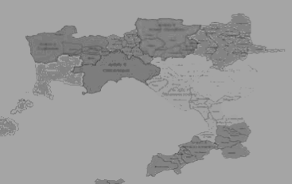
A Map of the Zones is drawn

Slide 15
Informative Systems
The informative systems were databases collecting data on schooling and on VET in the Provincia of Napoli emerging from a collaboration with an in-house public company (ASUB).
The data included information on school provision, statistics on the resident population, on the potential student population, the number of classes, of students enrolled, on the estimated population and student population over time (the archive was named ‘Anagrafica istituti superiori’ , and was made with the help of a common application for database making) as well as data on school buildings (the spreadsheet was called ‘Agenda degli interventi in edilizia scolastica’).
The informative systems supported the planning and educational policy-making by drawing on the circulation of reliable data, and on the relevant information of the socio-economic characteristics of the zones, as well as on the economic local policies and initiatives (Serpieri & Romano, 2008). The effort, here, was to support and consolidate an association between educational provision (its contents, and practices) and the socioeconomic dimension of the territories as reflected, and translated in the data, and the indicators of the informative systems.

Slide 16
A Network of Research
Three projects of collaboration with the Faculty of Sociology, Faculty of Economy, and the Faculty of Architecture of the University of Napoli “Federico II” were launched. The intention was to develop a space of research for groups of sociologists, economists and architects to support the development of a devolved and participatory educational policy-making, by furnishing solutions, imagining alternative scenarios, and legitimating the work of the Provincia of Napoli.
During the decade, additional knowledge producers were included, i.e. other universities and public research organisations, which were contacted once specific knowledge expectations emerged from the realisation of the devolved local educational environments.
These research groups set up ‘laboratories’ in order to collect data, experiment, and to develop knowledge on very relevant topics in the changing field of educational governance.

Slide 17
Conferences of Zones as ‘Little Parliaments’
Each zone has a Conference of Zone which is comprised of representatives of all of the schools (educational leaders) and the municipalities (mayors) in the zone, Representatives of the Regional Educational Office of the Ministry, the Entrepreneurs’ Union and the Centre for Employment are also members of the conference. In order to coordinate the decisions made within the local conferences, an additional ‘Conference of Conferences’ was created. It includes representatives elected from each ‘local conference’.
This complicated apparatus was intended to give weight to the locally-devolved environments of school governance. The map activates a regional space, i.e. containers with boundaries that include well defined entities (schools, social services, etc.). Even the Conference of Conferences of the Zone is thought of in terms of a container of other containers.

Slide 18
To summarise
Education zone emerges when a collective of agencies was put together, and in particular, an association of intermediaries and mediators was interconnected
The enactment of the education zone thus implied a complex assemblage of humans and nonhumans, particularly made by: a) the group of the Provincia of Napoli; b) a fragile bridge of texts resulting in deliberations; c) a map, d) an informative system; e) the enrolment of research groups, and f) the setting-up and activation of the conferences of the education zones.
Step-by-step, a machine for the deliberation of educational planning emerged and new spaces of education policy materialised.

Slide 19
Act Three: Multiple Enactments of the Space of Educational Policy-Making

Slide 20
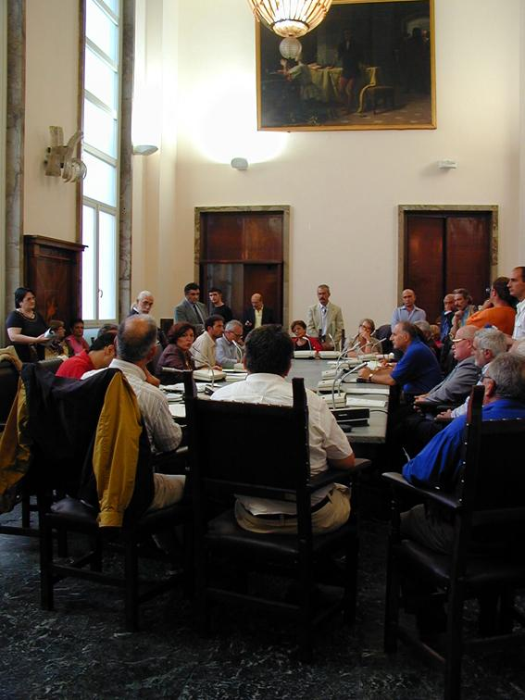
Response 2
The enactment of a space of policy-making does not follow completely the intentionality of the policy-makers. Collectives of agencies perform differently than expected and concur to the fabrication of patterns of relationship not envisaged before. Spaces can assume then multiple configurations: regions, networks, or fluids

Slide 21
Excursus 3
Space is not given, and is not necessarily forced into three dimension patterns. It helps to consider educational spaces (what is next, far, beyond, etc.) as relational formations which are not exclusively defined in terms of metric distance, but with regard to a multiplicity of attributes (identity, familiarity, etc.).
An interesting typology, drawing on Mol and Law’s work (Mol & Law, 1994), and then reconsidered by Sorensen (Sørensen, 2009) includes: regions (containing well-delimited entities); networks (connected elements); and fluids (relationships that change, but maintain a recognised identity).
The typology invites us to develop topological accounts of sociological practices, and to acknowledge how the materialisation of the space may have different instantiations. It recognises the multiplicity of spatialities in social fabric, and that some dominant instantiations are accompanied, and to some extent also challenged, by different performances of the social space.

Slide 22
The failure of education zones as machines for deliberation
(end of 2003 – half 2004)
Quite paradoxically from a linear perspective of policy analysis, the conferences of zones reveal to be a failure as machines for deliberation. Only a very small number of decisions are taken there, and most choices regarding educational planning are made elsewhere.
Instead of being machines for deliberation, they appeared to be hearings which were to be listened to, and where proposals could be made. They are no substitute for the usual avenues of choice (one-to-one relationships with a school, municipality, provincial offices and the Councillor) that are to some extent hidden from public accountability, and a collective discussion and deliberation.
Moreover, the association between schools and the economic characteristics of the territory tends to include schools, municipalities, and other participants in a too narrow, and fixed topological space. Schools frequently have weak relationships with other schools within the same zone, and with the secondary schools in the zone, which are seen as 'competitors'. Schools compete, generally, for the ‘better students’ to maintain, or increase their position in the ranking of the public prestige.

Slide 23
Zones as Fluid Spaces, or Networked Spaces (from 2005 to 2008)
The zone and the conferences of zones may also be seen as occasions for raising awareness of the reproduction of local circuits of schools responsible for tracking schools, and a higher percentage of school drop-outs, for developing collaborative forms of professional knowing aimed at creating local spaces of affinity among head teachers and groups of teachers, for producing projects, etc. and for intervening in and possibly reducing the persisting reasons for inequality.
In these cases, the zone is enacted less as a hierarchical site, and more as a fluid space in which school boundaries are open to reflection. The definition of the ‘zone’ becomes problematic, and the articulation of the conference of zone is again under construction. Here, the possibility emerges of developing a space for challenging school practices and rebuilding patterns of relationships with regard to knowledge-making. In the latter case, the zone becomes a place for exchanging knowledge and generating new perspectives on school governance.

Slide 24
Zones as Fluid Spaces, or Networked Spaces (from 2005 to 2008)
Example
In Zone 1, for example, a group of headteachers met regularly in 2005 and 2006 to elaborate on common strategies in educational guidance, and deal with the issue of student registration with the aim of potentially developing joint policy.
The group drew on a successful pilot project in one of the municipalities of the zone, where it had been possible to establish coordination of the secondary schools and those at the primary level, and to confront data about the potential students and the educational provision of the secondary schools. The group decided to extend the project to the entire zone and to envisage possible alternative scenarios of registration. Scenarios may lead to imagined critical points (uneven distribution of students among schools, choices directed towards some schools and not to others etc.), and to enactment of a proper strategy of guidance at the local, or at the provincial level. In 2006, the conference of zone discussed the project, and agreed to extend this policy inside the zone.
The agreement became a model, and was also announced in other zone conferences as an instance of the possibility of the logic of networks of schools, that is to favour the development of collaborative networks among secondary schools to counter the risks associated with non-collaborative, or overtly competitive relationships between schools.

Slide 25
In conclusion

Slide 26
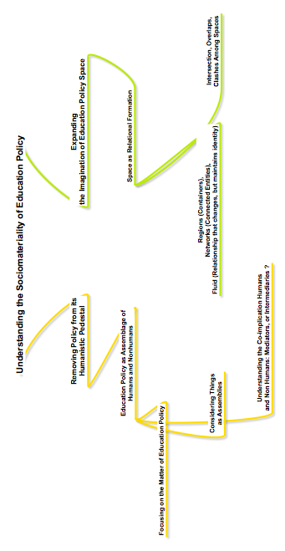
Theorising the Matter of Education Policy

