Slide 1
Remaking education at the nexus between governing and experience
Terri Seddon

Slide 2
Approaching a project
How to choose?
Theorist
Issue
Application

Slide 3
Fabricating Europe (2002)
Problematises the European education space
Targets policy rhetoric space of education
Investigates
the ‘ambiguous and fuzzy idea, of a European educational space, created by transnational governance, networks, cultural and economic projects’, and
the ‘possibility of a European public space for education/public spaces interweaved with education’ (p. 1 - emphasis added).
So what is special about this respatialisation that unfolds with europeanisation? How does ‘space’ relate to ‘education’? And why is this ‘space of education’ significant now, in this present?

Slide 4
Disturbing Work (2009)
How do lifelong learning reforms in teaching, nursing and social work reconfigure occupational orders and transform politics in working life?
A book project:
Editors: Finland, Germany, Australia
Contributors: Finland, Germany, US, UK, Australia
Illegible regimes of power provoke active process of subjectification:
The day-to-day struggle over the hearts and minds of human subjects is located not only within social structures … but also in the process whereby they perceive any given situation, approve or validate it, assess its goals as proper or worthy, repugnant or reprehensible. What emerged in our analysis as a particular way of processing the social world, as its appropriation by individuals, has to be seen as a field of conflict between dominant cultural values and oppositional attempts to wrest cultural meaning and pleasure from life. It is a compromise – a negotiation

Slide 5
Space of orientation
Governing
Learning
Experiencing
The art of politics ….. is not about defining the ‘right’ goal and then implementing it; the art of politics is about building connections, about creating a space of orientation which can re-contextualise fragmented struggles (Haug, 2010).

Slide 6
Research strategies
Narrative writing to clarify the focus and key issues.
Reflecting on research moments and projects to surface what I know.
Identifying research literatures that pin down concepts, clarify assumptions, and offer methodologies.
Interrogating the meaning, history and theory of the key concept.
Fixing a place to stand by defining space-time horizons, this-that present and discursive resources

Slide 7
Transnational knowledge building Between fabricating & disturbing Europe
Anchored in different experience (JB)
Travelling ideas, eurocentrism, historical memories & cultural habits (Connell)
Travelling ideas experienced as illegible regime of power (DW)
Concepts, methods and practices of transnational knowledge building through ‘bucket categories’ (Crosslife)
Respatialising governing as governance:
Space of dialogue acknowledges subsidiarity, legitimacy of knowledge but entangled with implicit hierarchies – demands governance (NCVER).
Territorial assumptions about the spatialisation of knowledge and place-based trust undercut governance through TNKB (EW)
Travelling ideas and cultural histories entangled through persons, places and politics – europeanisation as a case of economic and cultural globalisation
‘Global-national analytic borderlands’ now generalised horizons of experience but must be seen if governance to make sense (ALGC)
Education as means of orienting social learning to see, know and do work, learning and governing through TNKB

Slide 8
Disciplining research
Space
Time
Marx-Feminism
Globalisation Studies
Cultural sociology & Foucault
Adult Learning

Slide 9
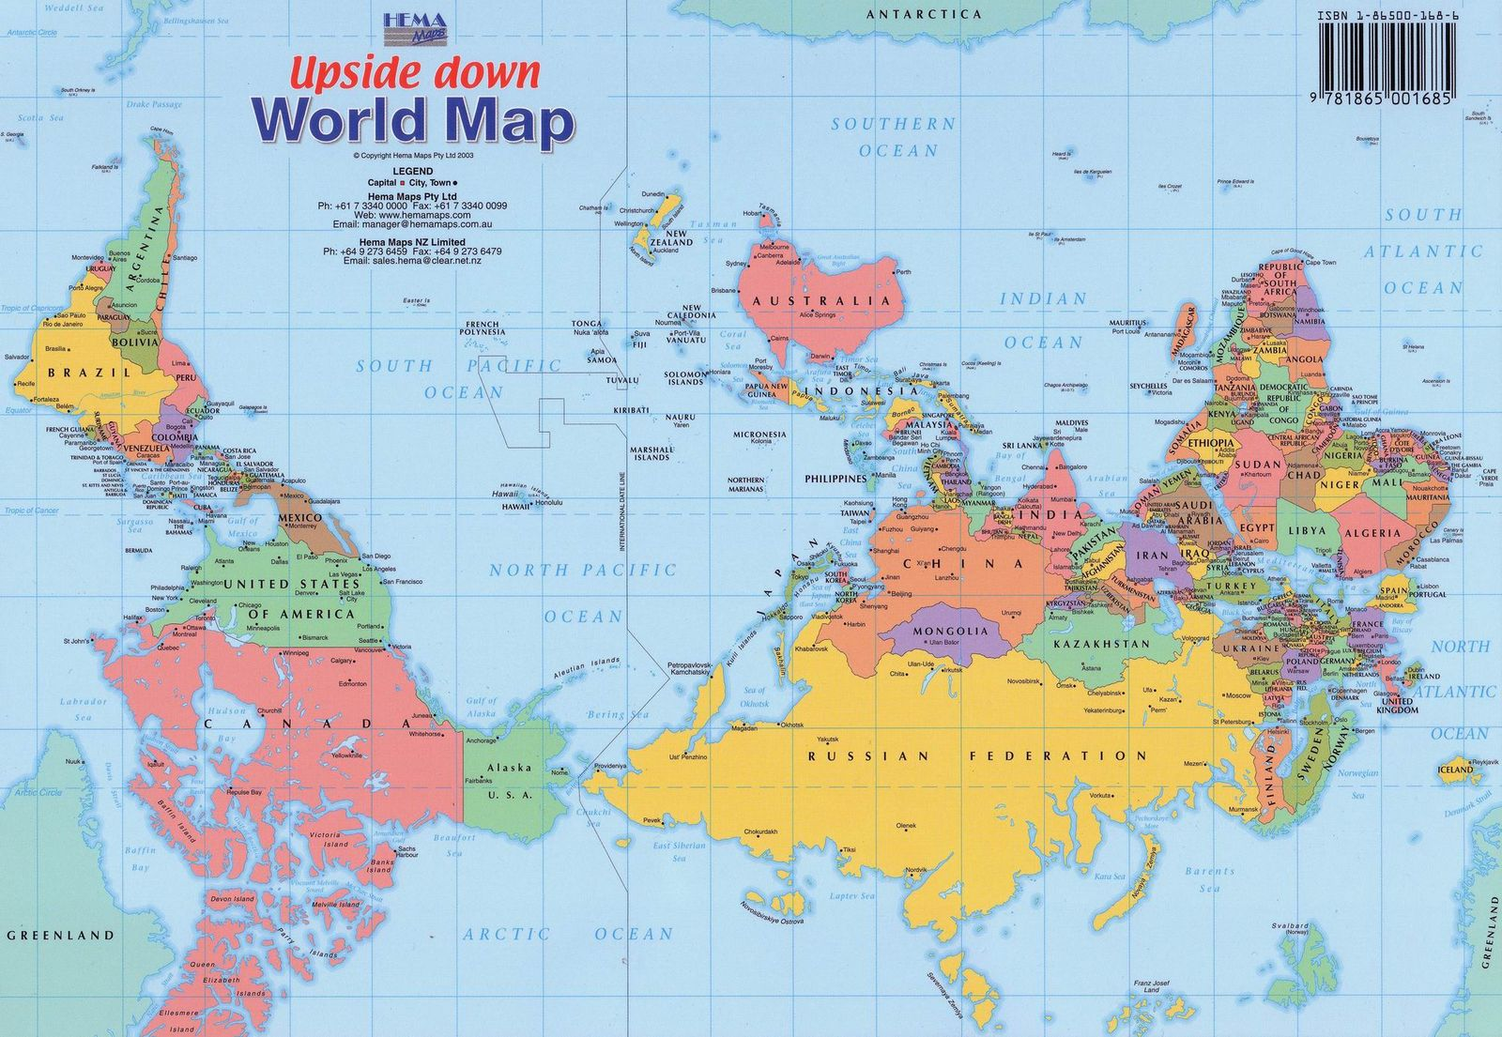
Space
Space has been evaded through:
Mapping: creates depthless horizontality – a surface without multiple trajectories (historical change, movements of things)
Representations: eg. ‘modernity’ flattens space to capture time (eg phases of development)
‘Relations’: structures that create causal closure to portray slices of time (‘prisonhouses of synchrony’)

Slide 10
From Europeanisation to Australianisation
Liquid learning – respatialisation of governing-experience through TNKB that reframes social learning
Educational work – labour that makes, orients and enacts space, which yields learning – discursively disturbed
Entangled histories of adult education
Relational space of education – institutional-ideational trajectories
Governing space-time through contextual narratives - steering
Navigating narrativities – working, learning, governing/claiming

Slide 11
Space – Place - Learning
Space is relational, fundamentally open, a simultaneity of stories-so-far and ‘infrastructure for the imagination’ (Massey) – perceived, conceived, felt (Lefbvre)
Space is the product of interrelations - space ‘as constituted through interactions, from the immensity of the global to the intimately tiny’ (Massey, 2005: 9).
Space is the sphere of the possibility of the existence of multiplicity - ‘as the sphere in which distinct trajectories coexist; as the sphere therefore of coexisting heterogeneity’ (Massey, 2005: 9).
Space is always under construction – ‘always in the process of being made. It is never finished; never closed’ (Massey, 2005: 9).
Place as event, a ‘throwntogetherness’ of presences and absences that contribute to its being made , a temporary stability, a particular ‘here and now’
.
Learning, unfolds through paradigms of knowledge and authority that govern and enable movements

Slide 12
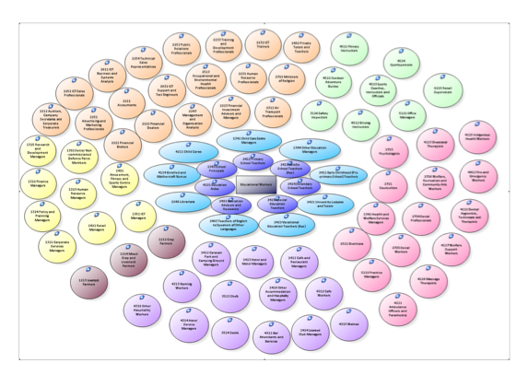
Lifelong learning as space of steering

Slide 13
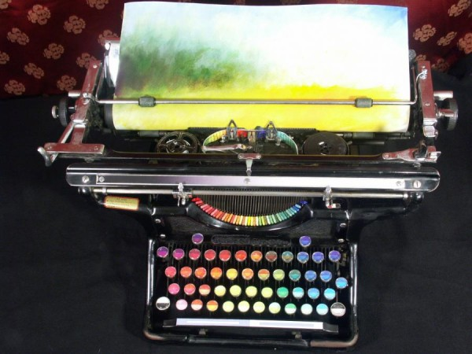
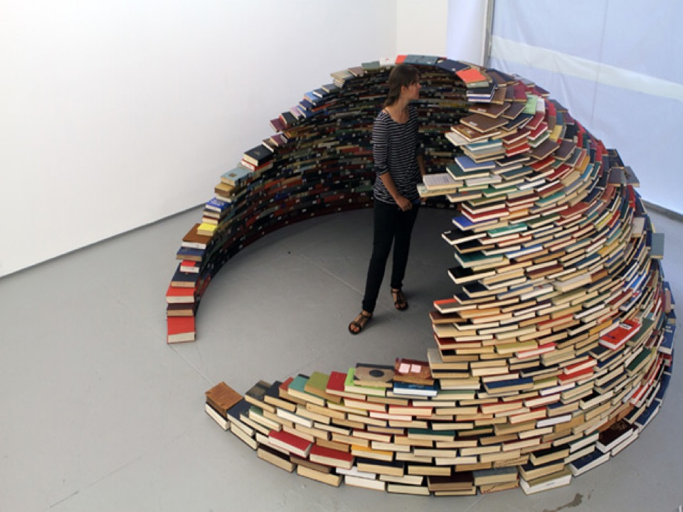
Education as infrastructure of imagination?
Population management?
Object of critique?
http://www.thisiscolossal.com/2011/12/the-chromatic-typewriter/
Or paradigmatic space-times that situate, authorise and control knowledge?
TNKB provides new methods, concepts & practices of education but the key question is still how this infrastructure for learning steers social learning with reference to contexts:
Spatial horizons defined through territorial and/or disciplinary power;
Practices of governing social inequalities, and
Necessary utopias imaged as probable or preferred futures
Notes:
Image 1 - Typewriter image: contemporary artist working with a 1937 typewriter to comment on the visual dimensions of the written word – the innovation of technology provides news ways of thinking about experience and knowledge.
Washington-based painter Tyree Callahan modified a 1937 Underwood Standard typewriter, replacing the letters and keys with colour pads and hued labels to create a functional “painting” device called the Chromatic Typewriter. Callahan submitted the beautiful typewriter as part of the 2012 West Prize competition, an annual art prize that’s determined by popular vote. I don’t know how practical painting an image with a colour typewriter is, but if Keira Rathbone can do it… (via dark silence in suburbia)

