Slide 1
An invitation to think with Luhmann’s system theory
Naples, July 2017
Eric MANGEZ

Slide 2
Task 1

Slide 3
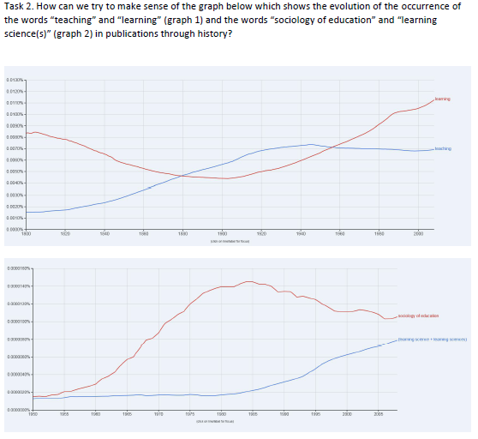
Task 2

Slide 4
An invitation to think with Niklas Luhmann’ system theory
Why this invitation?
“Our starting point is an assessment of the current status of sociology of education as increasingly marginal to both educational policy-making and the discipline of sociology” (Shain and Ozga 2001:110)
What we need is to reconstruct “sociologically-informed knowledge (…) that highlights the complexity and contradiction of educational institutions and that relates these issues to broader social configurations” (Shain and Ozga 2001: 112)

Slide 5
An invitation to think with Luhmann’s system theory
1. An invitation difficult to make and difficult to accept.
Superficial reasons : complexity of the theory
Profound reasons : anti-humanism, non-linearity, non-critical in the usual sense of the term
(2. From Bourdieu to Luhmann
National / global society
Epistemological positioning
Forms of differentiation)
3. The form of (modern) society
Modernity as functional differenciation
The Nation State as a temporary encapsulation of function systems
Globalization and the expansion of systems
4. The history of the future
The promodern future
The future of early modernity
The future of late modernity

Slide 6
1. A difficult invitation
An invitation difficult to make and difficult to accept.
Superficial reasons : complexity of the theory
Profound reasons :
anti-humanism
Does not assume that individuals can actually change society
Does not assume that individuals are the products of society
non-linearity: causality is replaced by notions such as self-organization, self-descriptions, autopoiesis and the key distinction between system and environment
non-critical (in the usual sense of the term)

Slide 7
2. From Bourdieu to Luhmann
Some key differences between Bourdieu and Luhmann
National / global society
Epistemological positioning
Forms of differentiation

Slide 8
3. The form of (modern) society
The (200 years long) switch from pre-modernity to modernity is a switch from segmented and hierarchical (stratified) societies to functionally differentiated society. It is the tipping point towards (what would later be called) globalization: from a world organized on basis of territories and hierarchy to a world organized into different domains (each dealing with a specific reference problem, such as education, science, art, politics, law, health, economy, religion).

Slide 9
3. The form of (modern) society
The (200 years long) switch from pre-modernity to modernity is a switch from segmented and hierarchical (stratified) societies to functionally differentiated society. It is the tipping point towards (what would later be called) globalization: from a world organized on basis of territories and hierarchy to a world organized into different domains (each dealing with a specific reference problem, such as education, science, art, politics, law, health, economy, religion).
The golden Age of the Nation State - encapsulating functional systems inside its territory and structurally coupling them - was and could only be a temporary arrangement (if not a mere illusion). Partially decoupled from its national context, each functional system is now tending to globalize itself. It then links up communicatively with other actors situated in other contexts but engaged in the same functional activity. This groundswell of globalisation leads each functional system to turn ever more towards its own processes and its own outputs

Slide 10
3. The form of (modern) society
The (200 years long) switch from pre-modernity to modernity is a switch from segmented and hierarchical (stratified) societies to functionally differentiated society. It is the tipping point towards (what would later be called) globalization: from a world organized on basis of territories and hierarchy to a world organized into different domains (each dealing with a specific reference problem, such as education, science, art, politics, law, health, economy, religion).
The golden Age of the Nation State - encapsulating functional systems inside its territory and structurally coupling them - was and could only be a temporary arrangement (if not a mere illusion). Partially decoupled from its national context, each functional system is now tending to globalize itself. It then links up communicatively with other actors situated in other contexts but engaged in the same functional activity. This groundswell of globalization leads each functional system to turn ever more towards its own processes and its own outputs
All functional systems have a tendency to expand themselves (spatially, temporally, thematically, socially). These tendencies (whose origin dates back to the tipping point towards modernity) become increasingly visible as we now live in one global functionally differentiated society.

Slide 11
4. The history of the future
The premodern future: stable, yet in the hands of God, inscribed in Nature
(“La société est devenue, aux confins de la modernité, son seul et unique point de reference” (Clam 2001))
The future of early modernity: the realization (building) of the nation, progress, “trust in the future” as an (inevitably) improved version of the past.
Education (national education) : curriculum + teachers + teaching + organizations + organized interactions are “the” main means for the nation to build itself by including all (young future) citizens into the system. The function of the “school form” (la forme scolaire, “teaching”) is to make these (otherwise improbable) interactions between the nation (in the form of the teacher) and the people happen.
The future of late modernity: with the globalization of functional systems, the world becomes (definitely) ungovernable and the future comes to be seen as (not necessarily chaotic but) unpredictable, full of risks and uncertainties, unknown. At the center of everything is the difference between the past and the future
Learning (to learn), transferable competences, problem-solving, projects without any fixed curriculum; learning anywhere, anytime, for anyone (not students only), with anyone (not teachers specifically) seems to be the only available response

Slide 12
The form of society, the history of the future
 | Premodernity | Early modernity | Late modernity
The form of society | Stratified society | Encapsulation and structural coupling of functional systems at national level (temporary -if not illusionary- arrangement) | Global functionally differentiated society
The future | Decided by God, inscribed in Nature | Building the nation | Risks and uncertainty
Policy | (Birth determines one’s life. Religious principles, social status in hierarchy) | Governing | Governance
Education | Preventing corruption, « moral education » Stratified. Religious. Ensuring souls' well-being | Teaching Curriculum, schools, teachers and pupils, organizations and organized interactions | Learning (to learn) Competences, dealing with uncertainty, anywhere, anytime, anyone with anyone

