Slide 1
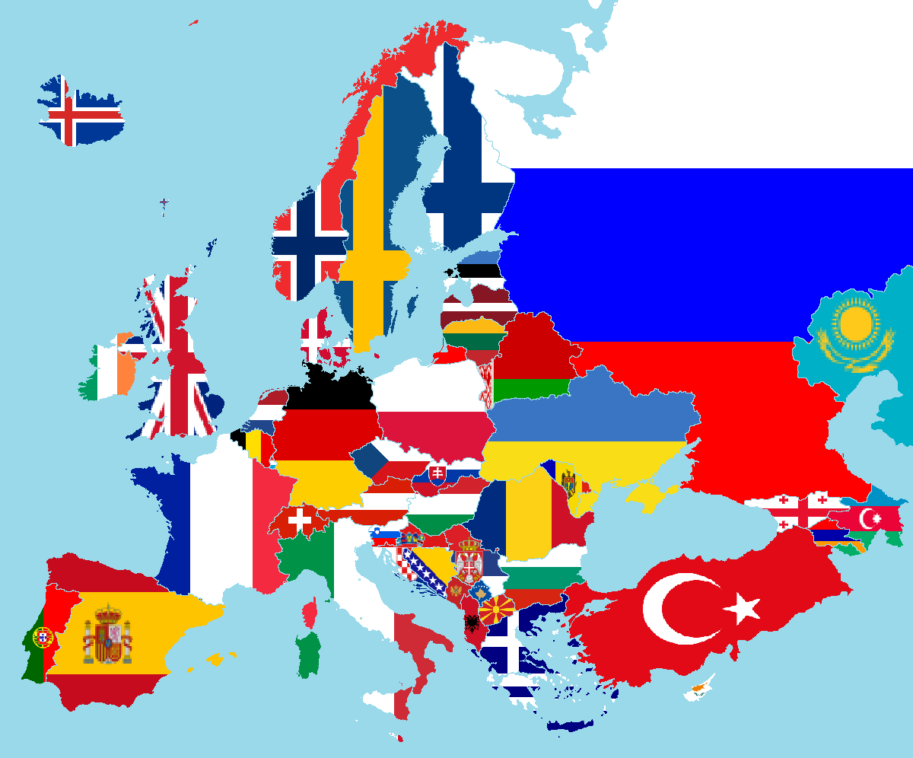
writing publishing europe pat thomson 2017

Slide 2
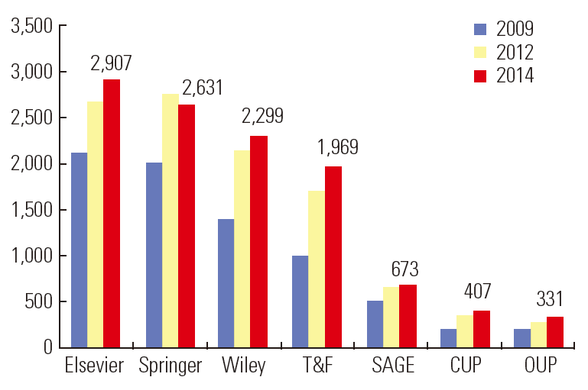
geopolitics of academic publishing 1
academic publishing is highly profitable
a global concentration of academic publishers
e-sciencecentral.org

Slide 3
Elsevier says its primary goal is to facilitate the work of scientists and other researchers. An Elsevier rep noted that the company publishes 1.5m papers a year; 14 million scientists entrust Elsevier to publish their results, and 800,000 scientists donate their time to help them with editing and peer-review.
“We help researchers be more productive and efficient,” Alicia Wise, senior vice president of global strategic networks, told me. “And that’s a win for research institutions, and for research funders like governments.”
Guardian 27 June 2017
https://www.theguardian.com/science/2017/jun/27/profitable-business-scientific-publishing-bad-for-science?CMP=Share_iOSApp_Other

Slide 5
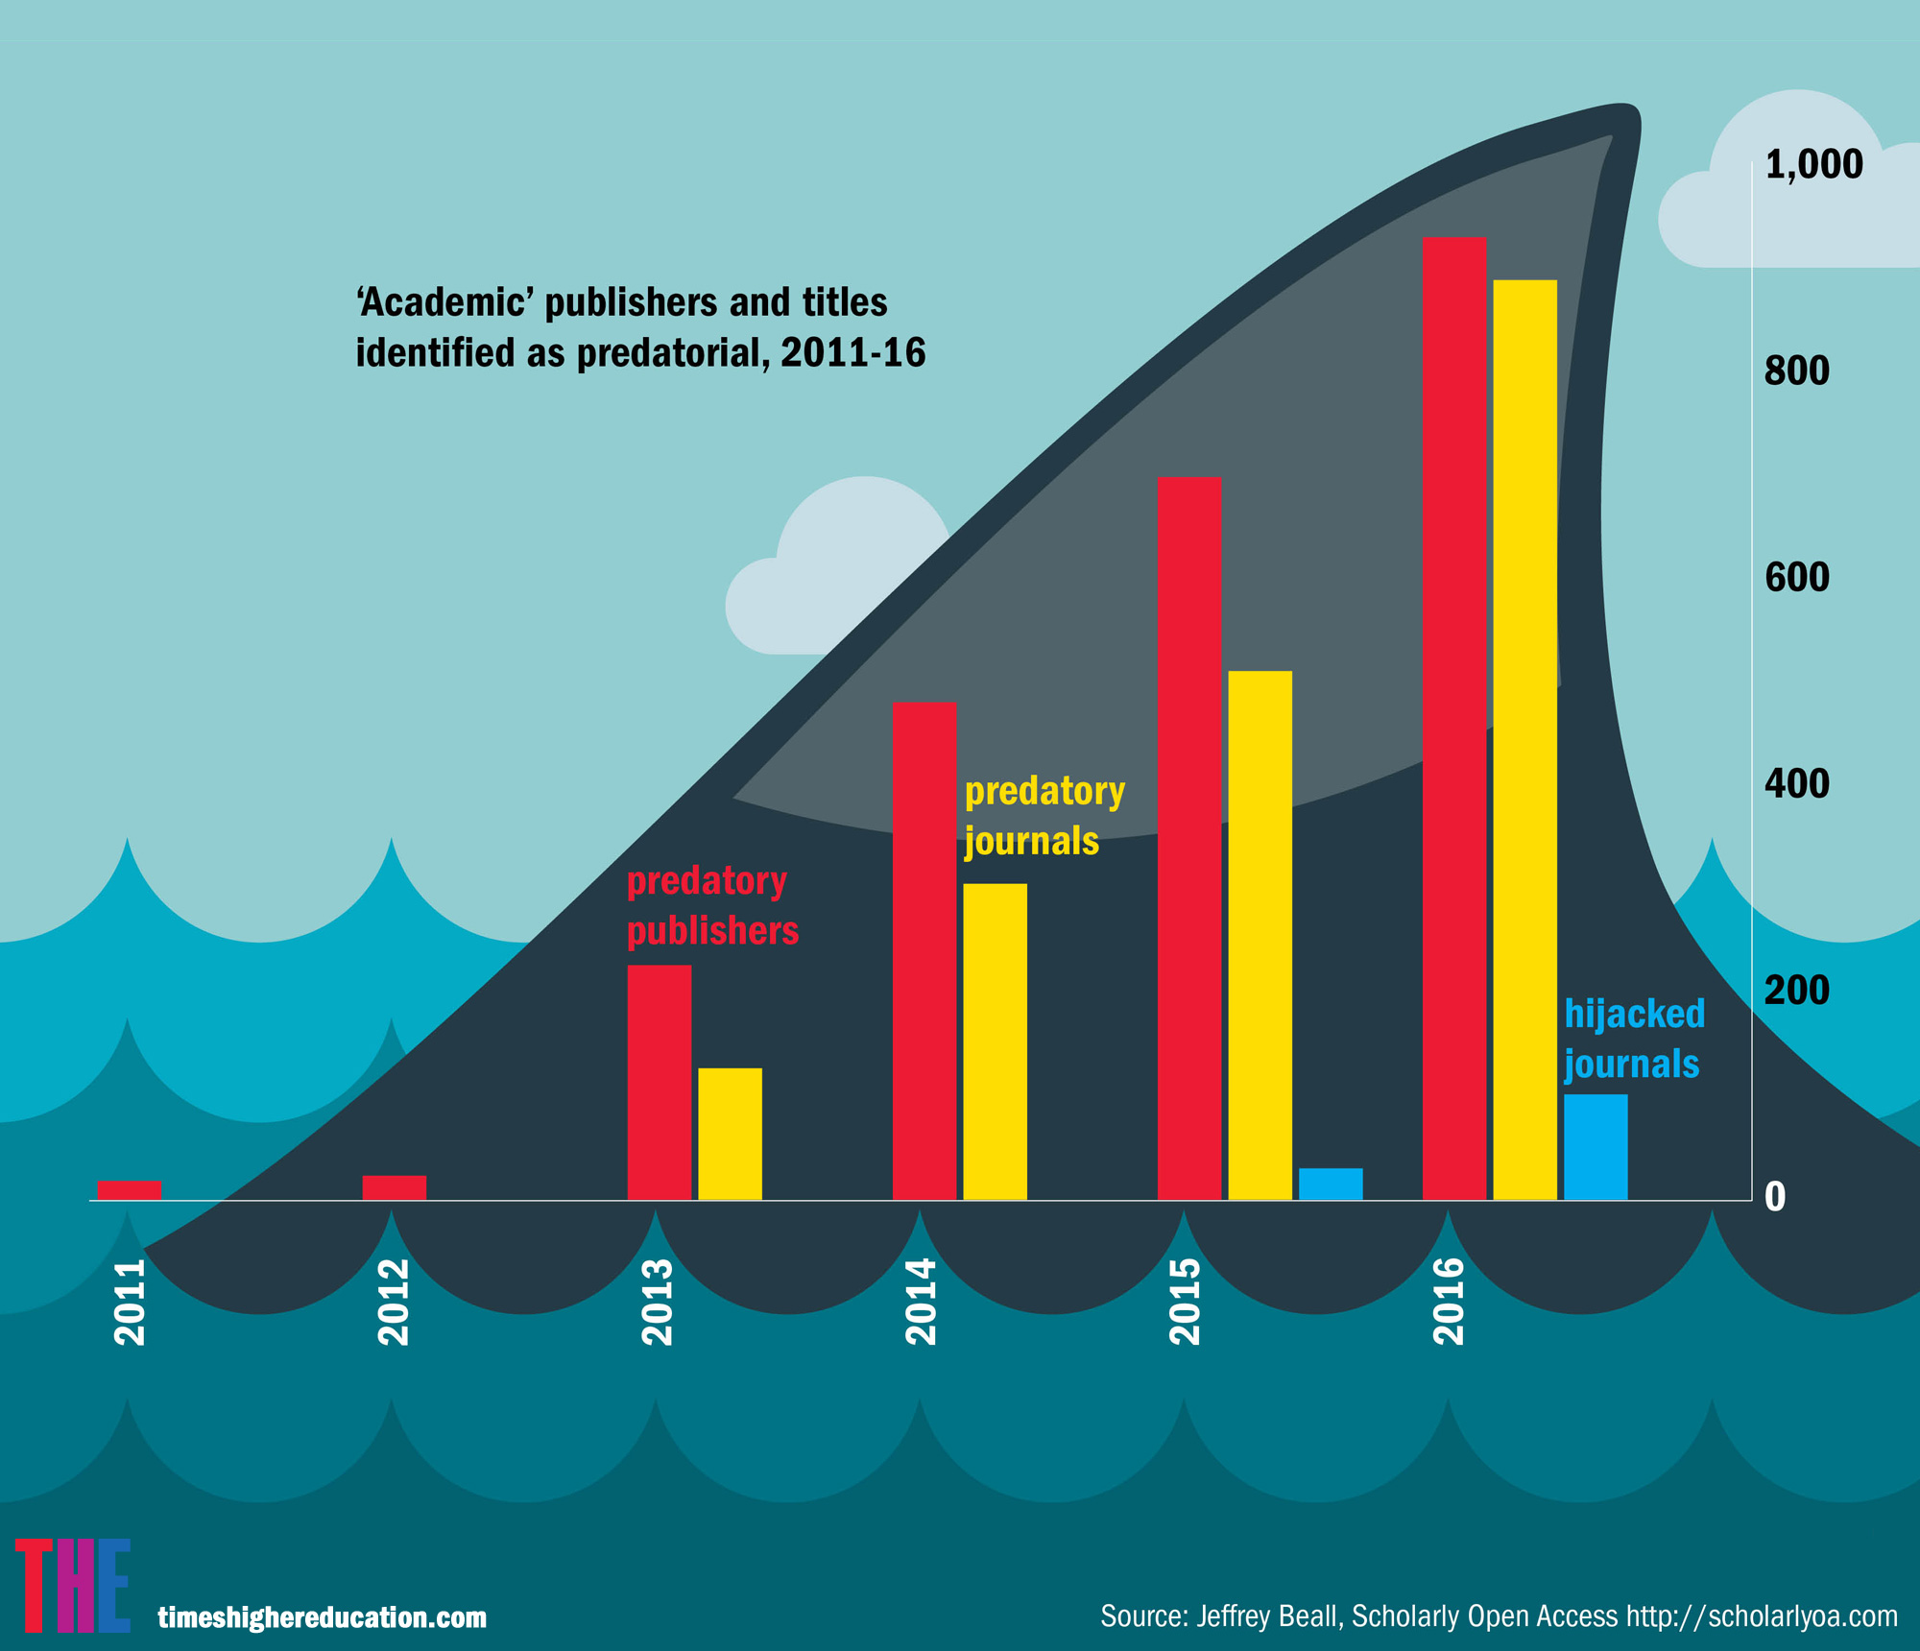

Slide 6
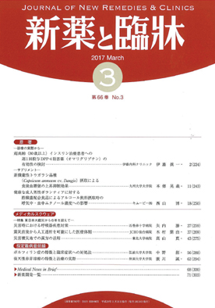
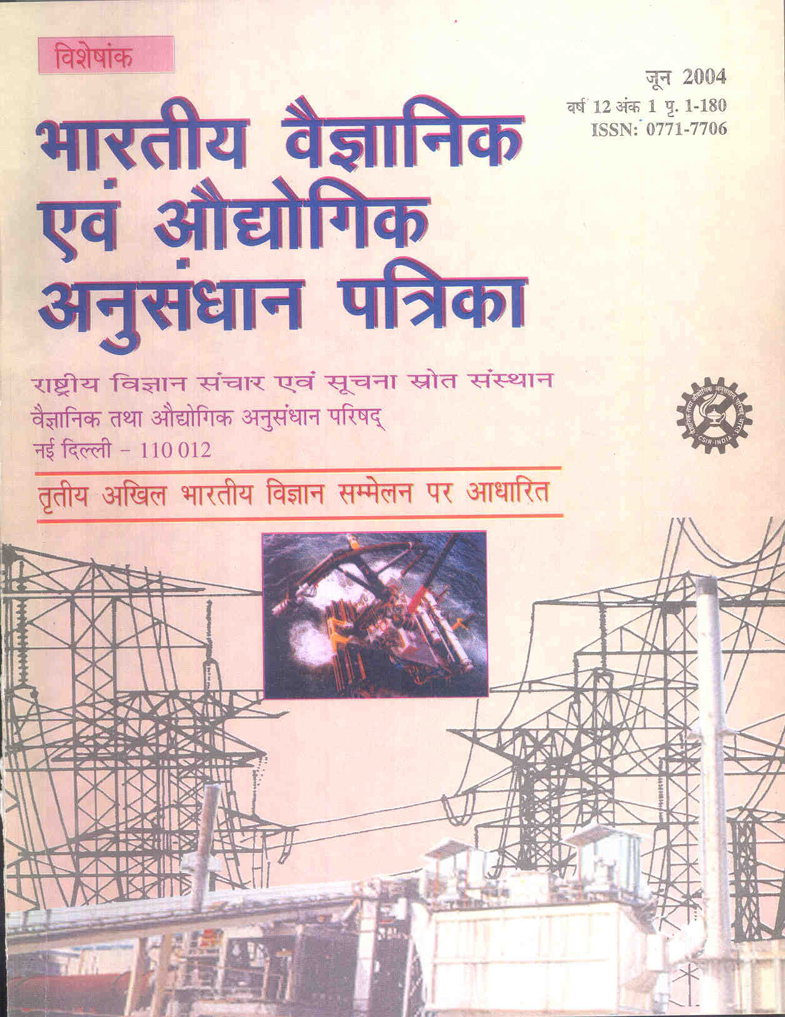
geopolitics of academic publishing 2
international focus on HE league tables and metrics
phd by publication
increase in english language publication and decrease of european and other language journals

Slide 7
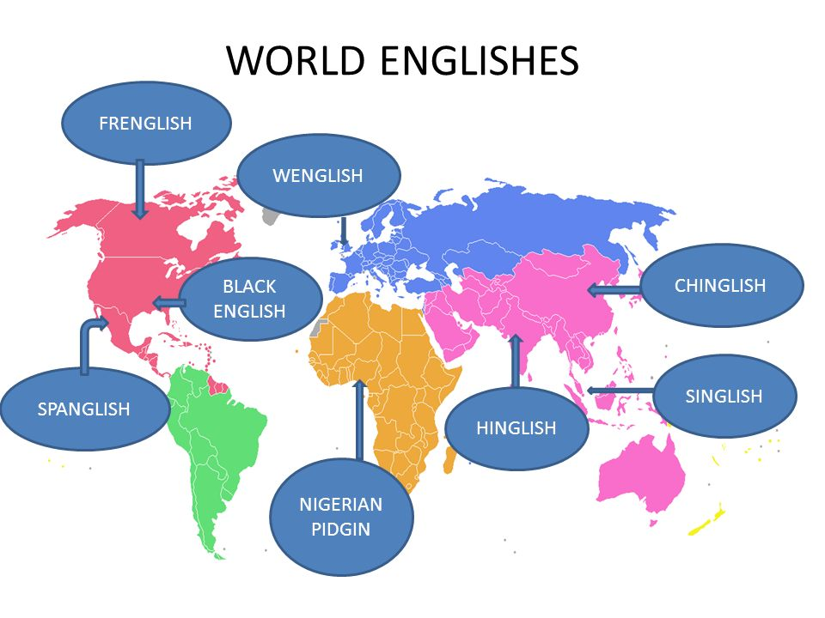
regimes of truth
only some forms of English are acceptable
some genres of academic writing are prioritised over others
lack of translation of books and papers
English speaking scholars rarely cite works not published in English

Slide 8
some important concepts are untranslatable

Slide 9
we are still teaching people to write monographs as phds
but
most academic monographs sell around 350 copies. this is the point at which they become profitable. some specialised books sell as little as 50 copies.
and global un-evenness
“academic books in africa, despite being produced and available for at least half a century, are now a rare sight to behold in the continent’s academic institutions.” dr ola ukulu.

Slide 10
strong continuities
the scriptural economy
The mastery of language guarantees and isolates a new power , a “bourgeois’ power, that of making history and fabricating languages. This power, which is essentially scriptural, challenges not only the privilege of birth that is, of the aristocracy, but also defines the code governing socioeconomic promotion and dominates, regulates, or selects according to its norms all those who do not possess this mastery of language.
De Certeau 1987 p. 139

Slide 11
The apparent neutrality of (academic) literacy (ies) disguises their significance for the distribution of power in society and for authority relations. The acquisition, use and revising of different literacies have an ideological character, that has not been recognised until recently.
Brian Street 1943-2017

Slide 12
text work/identity work
the academic self is formed/performed through writing and through
the choice of literatures, choice of tradition - epistemology/methodology, writing genre and style
feedback from others – how I think they see me – the role of supervision but also peer review, audience questions etc
institutional, disciplinary, policy frames

Slide 13
conserve –ing cultures and structures in HE
framing discourse practices
mediay
text
mediation
Kamler and Thomson adapted from Fairclough

Slide 14
academic precariat plus performativity
press to publish
quantity and quality both ‘count’
public engagement – write for multiple audiences in multiple genres
impact – ‘show’ what’s happened
a lot of ‘good advice’ and advocacy

Slide 15
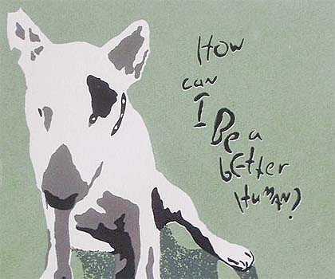
Foucault reminds us of…
population regulation via productive technologies of
responsiblisation
normalisation
individuation
fragmentation
repetition
but power CIRCULATES…

Slide 16
fightback?
institutional boycotts
academic boycotts
alternative platforms (some however now monetised)
open access
self publishing

Slide 17
strategies
work with/against existing policies and social practices (Patti Lather)
deep expertise provides a place from which to argue back (Pierre Bourdieu)
combine a practice of critique with that of augmentation (Brian Massumi)
feminist killjoy ( Sara Ahmed)

Slide 18
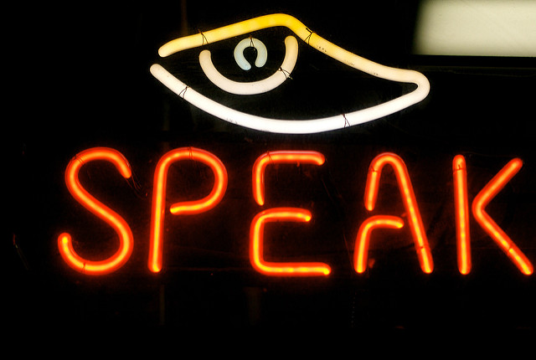
reflexivity - margaret archer
reflexivity: “the regular exercise of the mental ability, shared by all people, to consider themselves in relation to their (social) contexts and vice versa.”
reflexivity mediates structural /cultural influences on the courses of action we take

Slide 19
“Writing as a personal exercise done by and for oneself is an art of disparate truth - or, more exactly, a purposeful way of combining the traditional authority of the already-said with the singularity of the truth that is affirmed therein and the particularity of the circumstances that determine its use…
…. a formation of the self out of the collected discourse of others. “
(Foucault, The Hypomnemata)

Slide 20
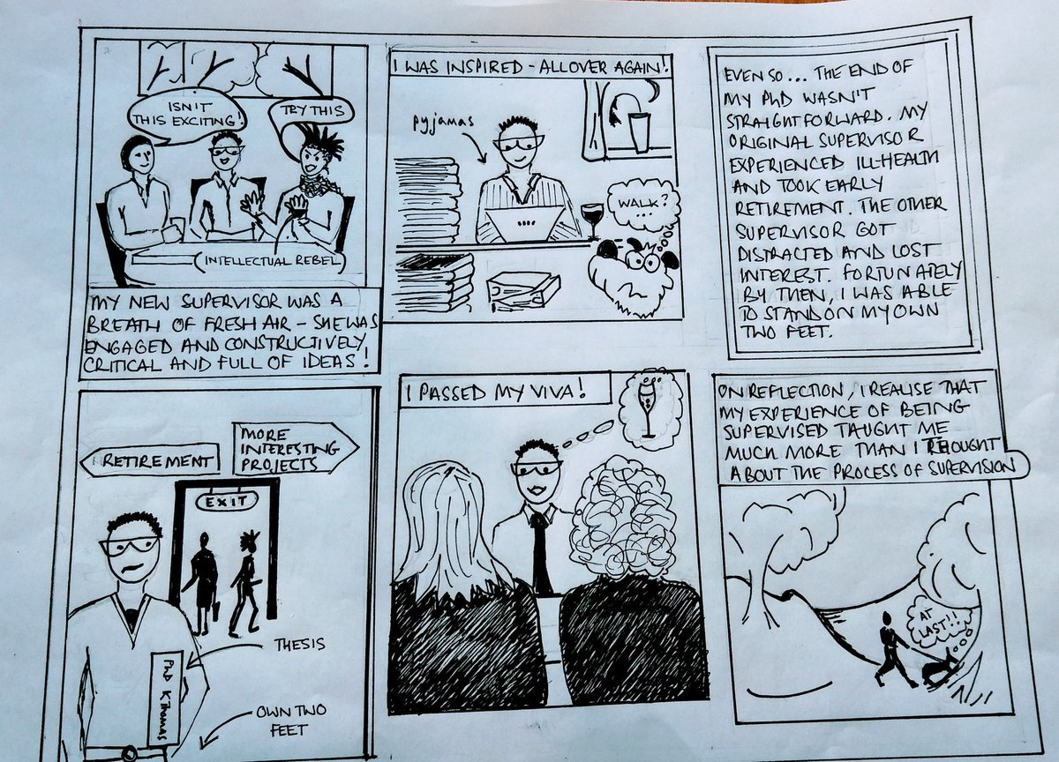
multi-lingual writing
genre bending
social media
by someone on twitter ☹

Slide 21
collaboration
“It is no accident that both my research and writing partners are also second wave feminists, generationally disposed to believe that there is strength in solidarity, joy in the kinds of intimacy that shared experiences can bring, and power in bringing more than one mind and body to an activity. Working together is a safety net, a way to get things done, but also an ongoing source of inspiration and support.
But long term research and writing relationships are more than simply instrumental. They require trust built on shared values, beliefs and experiences.
They bring satisfaction in joint achievement, comfort in the face of institutional unreason, moments of revelry, excitement and mirth. They are, to be somewhat trite, shelter in the higher education storm.”
( me, in press)

