Slide 1
Summer School in in European Educational Studies1st. ed.
July 06th 2017
From Ideological Apparatuses to Governmentality Dispositif: School Leadership in European Educational Studies
Roberto Serpieri
Department of Social Sciences University of Naples Federico II
profrobertoserpieri@gmail.com

Slide 2
In order to adopt a beyond ideology foucauldian perspective, my aims are intended to show how educational leadership represent a key dispositif for neo-liberal school reforms.
In particular, in a foucauldian perspective, the concept of dispositif plays a strategic role at the intersection of governmentality, regimes of truth, and technologies of the self.
The dispositif is a historical formation of heterogeneous elements as discourses, institutions, rules, scientific knowledge(s), and so on: ‘[t]he apparatus itself is the system of relations that can be established between these elements’ (CF: 194); sort of a contextual and mobile configuration (see Revel 2015).
Grounded on a ‘new’ conception of power and challenging its ideological function it is distinguished from other conceptions of State apparatus, such as the ‘Ideological State Apparatuses’ (Althusser 1971).

Slide 3
Thus three implications are relevant:
the abandonment of a conspiracy theory of the leading class and of the bourgeois hegemony like in Gramsci;
methodologically, there is no ‘unspoken’ and invisible’; in the discourse ‘both a certain transparency and certain forms of exclusion […] are integral part of the analysis and transparency may be so transparent to obscure’ (Harcourt 2015: 289); In a comment to his Archaeology of knowledge, Foucault clarifies: ‘[w]hat I look for are not secret, hidden relations, that are more silent or more profound than the consciousness of people. I try rather to define relations that are on the surface of discourse; I try to make visible what is invisible only because it’s too much on the surface of things’ (quoted in PS: 289)
‘ideology stands in a secondary position relative to something which functions as its infrastructure, as its material economic determinant, etc. For these three reasons, I think that this is a notion that cannot be used without circumspection’ (TP: 118, im).

Slide 4
Therefore our questions are the following:
How do discursive formations arise to fabricate the ‘reality’ of leadership?
What are the epistemic premises, the regimes of truth that define leadership?
Which kind of subjectivation encapsulates head teachers through technologies of governmentality?
What freedom can be practiced?
There is space for ethical choices?
What alternative truths are in play to resist against neo-liberal education policies?

Slide 5
The ideological ‘suspect’
The emphasis on practices, through an ‘anti-institutionalist’ approach (as presented in PP: 42 and HS: 117) focused on microphysics of power, leads Foucault to suspect of the ideological issue more and more.
Here a different conception of power is in play: ‘power is not conceivable as an instrument, as something possessed, nor as an ideological apparatus, but must be thought of as a primary and constitutive factor’ (Harcourt 2015: 288). Power cannot be divided between repression (the Repressive State Apparatus that works by violence) and ideology (the Ideological State Apparatuses).
In respect to Althusser’ distinction between ideological and repressive apparatuses Foucault proposes a more fluid conception instead of the State apparatus model: ‘an intra-state system’ or ‘relays-multipliers of power, (PS: 209) where the emergence of the idea of the State as an ‘episode in governmentality’ (STP: 248, im) comes to the fore; whereas ‘[t]he state is nothing else but the mobile effect of a regime of multiple governmentalities’ (BBP: 75, im).

Slide 6
Therefore it is in the transition to the genealogical phase that the analysis of the practices focuses more clearly not only on the knowledge (savoirs), but on ‘regimes of truth’ intertwined with power relations [techniques and practices of Governmentality] which make the dispositif a central knot for Foucault’s theory of the power/govern. Dreyfus & Rabinow (1982).
The question here is the same as the question I addressed with regard to madness, disease, delinquency, and sexuality. In all of these cases, it was not a question of showing how these objects were for a long time hidden before finally being discovered, nor of showing how all these objects are only wicked illusions or ideological products to be dispelled in the [light] of reason finally having reached its zenith. It was a matter of showing by what conjunctions a whole set of practices – from the moment they become coordinated with a regime of truth – was able to make what does not exist (madness, disease, delinquency, sexuality, etcetera), nonetheless become something, something however that continues not to exist. That is to say, what I would like to show is not how an error – when I say that which does not exist becomes something, this does not mean showing how it was possible for an error to be constructed – or how an illusion could be born, but how a particular regime of truth, and therefore not an error, makes something that does not exist able to become something. It is not an illusion since it is precisely a set of practices, real practices, which established it and thus imperiously marks it out in reality.
The point of all these investigations concerning madness, disease, delinquency, sexuality, and what I am talking about now, is to show how the coupling of a set of practices and a regime of truth form an 'apparatus' (dispositif) of knowledge (savoir)-power that effectively marks out in reality that which does not exist and legitimately submits it to the division between true and false (BBP: 19, im).

Slide 7
The abandonment of ideology combines here with the issue of subjectivation, which challenges a theory of the ahistorical and monolithic subject and explores the constitution of diverse subjectivities within the subject himself, along with historical and contingent formations.
There were practices – essentially the widespread use of incarceration […] – that sent me back to the problem of institutions of power much more than to the problem of ideology. This is what led me to pose the problem of knowledge and power, which for me is not the fundamental problem but an instrument that makes it possible to analyse the problem of the relationship between subject and truth
What I wanted to try to show was how the subject constituted itself, in one specific form or another, as a mad or a healthy subject, as a delinquent or no delinquent subject, through certain practices that were also games of truth, practices of power, and so on. I had to reject a priori theories of the subject in order to analyse the relationships that may exist between the constitution of the subject or different forms of the subject and games of truth, practices of power, and so on.
[The subject] is not a substance. It is a form, and this form is not primarily or always identical to itself. You do not have the same type of relationship to yourself when you constitute yourself as a political subject who goes to vote or speaks at a meeting and when you are seeking to fulfil your desires in a sexual relationship. Undoubtedly there are relationships and interferences between these different forms of the subject; but we are not dealing with the same type of subject. In each case, one plays, one establishes a different type of relationship to oneself. And it is precisely the historical constitution of these various forms of the subject in relation to the games of truth which interests me (ECS: 289-290, im).

Slide 8
Leadership: a neo-liberal ‘dispositif’?
The dispositive bears on the relationship between regimes of truth, technologies of governmentality, and forms of subjectivation and, as for the wonderful metaphorical definition proposed by Deleuze (1999), it cannot be interpreted simply as an heterogeneous assemblage of disparate elements, but it is also traversed by dynamic field of relations, to allow some approximation of a particular preponderance or balance of forces at a given time creating both subjects and objects.
In a recent work focusing on policy dispositif neo-liberal education policy dispositif in England, Bailey (2013) recalls the scalar dimension of a dispositif that can be located both at the micro and at the macro level. Foucault himself has insisted on the movement between those different levels of analysis, at the moment when his ‘strategic’ conceptualisation of power was prevailing.
There is no discontinuity between them, as if one were dealing with two different levels (one microscopic and the other macroscopic); but neither is there homogeneity (as if the one were only the enlarged projection or the miniaturization of the other); rather, one must conceive of the double conditioning of a strategy by the specificity of possible tactics, and of tactics by the strategic envelope that makes them work (HS: 99-100).

Slide 9
In this respect, leadership can be understood as a policy dispositif that produces its effects both at the macro level (from accountability to quasi-market, etc.…), and at the micro levels of organisation and management in every single school.
More specifically, the leadership design (Gronn 2003) of neo-liberal education is instrumental toward aims of entrepreneurship, competition and selection.
Leadership is said to be instrumental to those ends, capable of achieving what was not possible under previous regimes where the emphasis may have been on such things as administration, management, expectations, and professionalism. Leadership, therefore, is a tool designed for a particular purpose. It is designed to achieve what might not otherwise be achieved (Gillies 2003: 21, im).

Slide 10
Contexts and discourses
In this contribution the analysis of leadership regime of truth is stressed using two dimensions of discursive formations: the scientific paradigms and the enlarged system of leadership knowledge (savoir) (this one recalling the ‘ideological functioning’ for the archaeological Foucault).
The first dimension refers to Seddon’s (1994) distinction between ‘categorical’ and ‘relational’ education contexts.
The other discursive dimension refers to the classical tripartition between conflicting discourses: welfarism and bureau-professionalism (Clark and Newman 1997); neo-liberal managerialism (Thrupp and Willmott 2003); and democratic-critical (Grace 1995; 2000).

Slide 11
DISCOURSES (Olssen et al 1994)
1. The bureau-professionalism (welfarism):
- formal and procedural rationality
- legitimacy and autonomy of professional expertise
- understanding of educational leadership as a professional practice, both of leaders and teachers.
2. The neo-liberalist (managerialism)
- efficiency and quasi-marketization
- accountability and competition
- leadership as a matter, delegated (distributed) to the followers.
3. The democratic-critic discourse:
- a critical reaction to the neo-liberalist policies,
- metaphorical interpretation
a) processual construction
b) questioning of its hierarchical nature.

Slide 12
Gewirtz & Ball, 2000

Slide 13
Discourse Context | Welfarist (Bureaucratic-professional) | Neo-liberal (Managerialist) | Democratic (Critical)
Categorical: individual-interactive | - Instructional - Moral | - Transformational - System Leadership - Distributed (or to be distributed?) | - Styles (of micropolitics) - Micropolitics - Collaborative
Network-practices | - Sustainable - Distributed (in practice) | ? | - Feminist - Greedy leadership work (distribution of) - Ecological - Democratic - Configuration - No leadership at all (neo-liberal tiranny)

Slide 14
Thus, in our map, it can be noticed that different conceptions and approaches to leadership representative of a managerialist discourse avoid the serious questioning of educational context and adopt individualist ontologies based on human, especially leadership qualities and interaction with followers.
The neo-liberal dispositif of distributed leadership is, e.g., definitively put in practice in a very ponderous research-report that tries to demonstrate the Impact of School Leadership on Pupil Outcomes (Day et al., 2009), whereas the methodological and statistical paraphernalia of an empirist and deterministic paradigm are deployed.
And so it is possible to find such an idea of distributed leadership:
it is a mere variable – certainly not a process in an educational context;
within some path analysis models it is located as intervening variable between independent variables such as: leader trust in teachers, redesigning organisation, setting directions, etc.;
and dependent variables such as: improvement in pupil behaviour and attendance and students’ outcomes (measured in a standardized way);
together with other intervening variables typical of the managerialist conception of a professional culture to be manipulated such as: senior leadership team collaboration, teacher collaborative culture, staff climate, etc.

Slide 15
Heads Perception of Leadership Practices and Change in Pupil Outcomes over Three Years (2003-05),
Structural Equation Modelling with standardised solution displayed (Secondary), Day et al. 2009: 92.

Slide 16
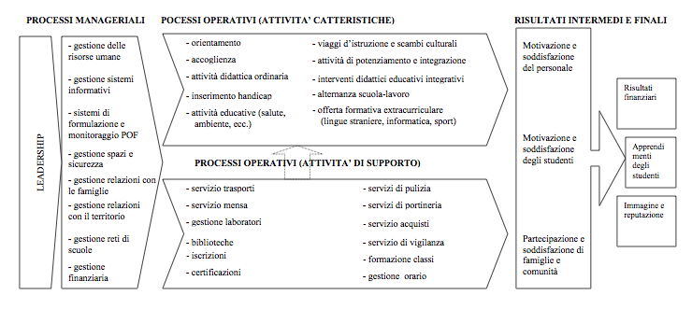
Italian Model of the European Foundation for Quality Management (EFQM).Paletta 204

Slide 17
Philip Hallinger and Ronald H. Heck
Conceptual and methodological issues in studying school leadership effects as a reciprocal process
School Effectiveness and School Improvement Vol. 22, No. 2, June 2011, 149–173

Slide 18
Collaborative Leadership and Teachers Wellbeing
Serpieri.Vatrella.2017

Slide 19
It seems clear how this knowledge is connected to practices of head teacher’s selection, training, evaluation and promotion that explicitly recall knowledge(s) that subjectivate leaders as school managers, whose organisation and objectives are flattened on the model of educational enterprise.
This leadership dispositif subjectivates the head teachers enabling them to redesign the educational context, both external and within the school, and where what strategically count are personal ‘super’ qualities, sort of a clever puppet master of distributed leadership.
The dominant paradigms of leadership through heroic performances, leader designer frameworks and best-practice models that are so pervasive have little or no rigorous theoretical underpinnings, and as such the feasibility of these ‘more traditional’ approaches in terms of providing a means for critical self-reflection needs to be seriously questioned (Niesche 2011: 18).

Slide 20
Leadership deconstruction
Leadership as policy dispositif, of which transformational and distributed are probably the most relevant ones, produces a regime of truth and technologies of governmentality to put in practice a neo-liberal education model pursuing educational goals congruent with those of competitiveness, selection, performativity and so on. In such a way it subjectivates head teachers, teachers, students and families as entrepreneurs of themselves (for this metaphor see BBP).
Thus, it should be emphasized that critical knowledge(s) about leadership countervail neo-liberal knowledges on the one side, adopting more sophisticated conceptions focused on a democratic idea of leadership significantly ‘engaged’ in a structural and cultural educational context, as for the case of Woods’ democratic leadership (2005) inspired by Archer’s morphogenesis, or for the distributed leadership in practice as for Spillane (2006) (we could also quote the Leadership for learning of MacBeath et al.)
On the other side, critical contributions conceive of the leadership dispositif just as one of the tyrannies (along with accountability, performativity, and so on) of neo-liberal education, as witnessed by the absence of the leadership theme in the ‘critical’ Handbook of Sociology of Education (Apple, Ball, Gandin, 2010).

Slide 21
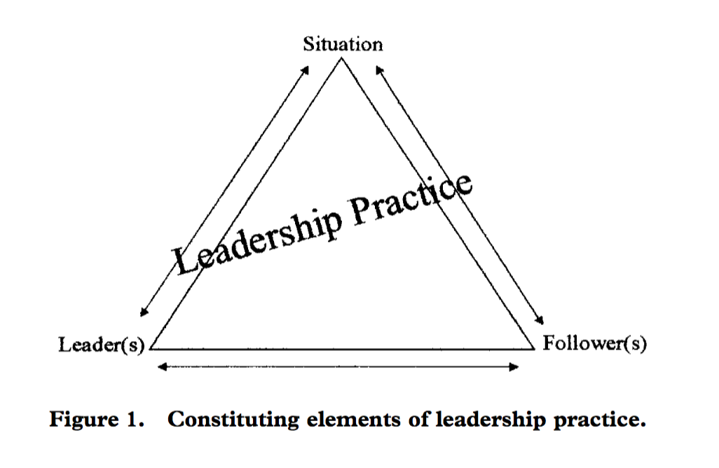
Derived from Engstrom’s Activity System Theory (Spillane 2006)

Slide 22
structure
structure
engagement
engagement
person
person
Woods, 2005

Slide 23
Not researching leadership?
This is the case of Ball and his colleagues, who more recently have developed an interpretation of leadership as imbricated into discursive formations and educational contexts, that Gunter has signalled as an original way of ‘not researching leadership’ (2013).
Thus, in researches conducted on the shifting from welfarist to neo-liberal discourse (Gewirtz and Ball 2000), the head teacher is conceived as discursive catalyst in school contexts. Such understanding of school leadership refers to sophisticated and thick descriptions of head teachers’ and teacher’s biographies, seen as a key interpretative dimension useful to understand the shift of the welfarist discourse toward the neo-liberal ones.

Slide 24
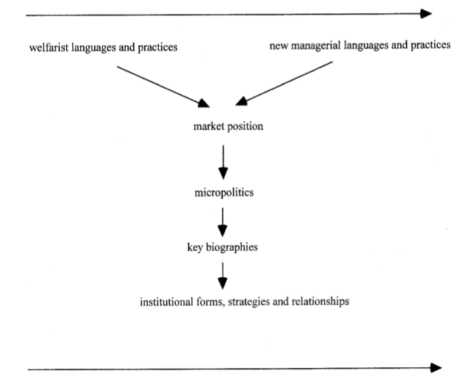

Slide 25
Taking context seriously
‘Key biographies’ do not play any causal role, as for the neo-liberal leadership dispositif, meanwhile are rather intended to show how school contexts change through complex, non-linear and contingent processes. A genealogical interpretation of problematisations is put into play: and biographies show how some processes of re-subjectivation are not ideological, but catalyse, code and recode and enact diverse educational truths.
A precious contribution in this direction comes from recent researches on policy-enactments in schools (Ball et al. 2012), where it is important to: ‘taking context seriously’, together with ‘policy artefacts’, ‘discourses, representations and translations’.
Thus, policy enactment involves creative processes of interpretation and recontextualisation – that is, the translation of texts into action and the abstractions of policy ideas into contextualised practices – and this process involves ‘interpretations of interpretations’ (…), although the degree of play or freedom for ‘interpretation’ varies from policy to policy in relation to the apparatuses of power within which they are set and within the constraints and possibilities of context. Policies are not simply ideational or ideological, they are also very material (Ball et al 2012: 3).

Slide 26
These researches, inspired by practice epistemology and ontology (where processes and non human actors do matter) and democratic and critic discursive formation, do not leave space for leadership as dispositif in a neoliberal way.
They show how some roles are enacted by educational professionals, such as ‘narrators’, ‘entrepreneurs’, ‘transactors’, ‘translators’, and so on, but there are no any leaders (49).
In other words, they propose a ‘leadership configuration’ (Gronn 2010), that is a plurality of roles or, even better, a ‘contextual configuration’, historically situated, and ‘mobile’, open to ethical freedom and creativity (Revel 2015) in a foucauldian way.
Moreover, the authors construct a map of such a school configuration where, paradoxically, both leader and leadership disappear.

Slide 27
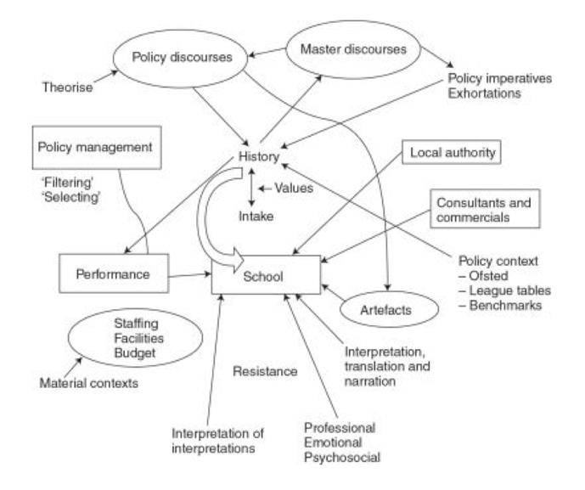

Slide 28
Such a configuration, which could be labelled ‘without leadership’ (Serpieri, 2008), opens up interesting scenarios that allow us to explore the ‘potentials’ (Gronn, 2009) for ‘democratic leadership’ (Woods, 2005), in order to deconstruct the neo-liberal dispositif of leadership.
This perspective drives us to reflect on the way in which head teachers can carry on their discourse about leadership: critical, resistant, and bearer of truths that are different from the neo-liberal discourse; but also to explore the ethical spaces of freedom (Laidlaw, 2014), that let head teachers to enact a parrhesiastic life (Ball, 2015; Ball and Olmedo 2013).
However, foucauldian lesson reminds us that an escape from dispositif and regimes of truth is never fulfilled and that we will always been subjectivated through diverse technologies of governmentality: according to our ethical choice of practicing a ‘courage of truth’ (CT), to think other ‘possibilities’ (Ball 2013) for exploring more democratic leadership configurations outside of neo-liberal policy dispositif.

Slide 29
Thus let’s recall our questions:
How do discursive formations arise to fabricate the ‘reality’ of leadership? Thanks to Governmetanlity Practices (not only Discursive ones)
What are the epistemic premises, the regimes of truth that define leadership? Individualism and Rationalism (Neo-Liberal Paradigm)
Which kind of subjectivation encapsulates head teachers through technologies of governmentality? As Levers of Neo-liberal Reform
What freedom can be practiced? As (self)Entrepreneurship
There is space for ethical choices? Through other Regimes of Truth and other Governmentality Practices
What alternative truths are in play to resist against neo-liberal education policies? Enacting other Subjectivities (Subjectivation vs Subjection)

Slide 30
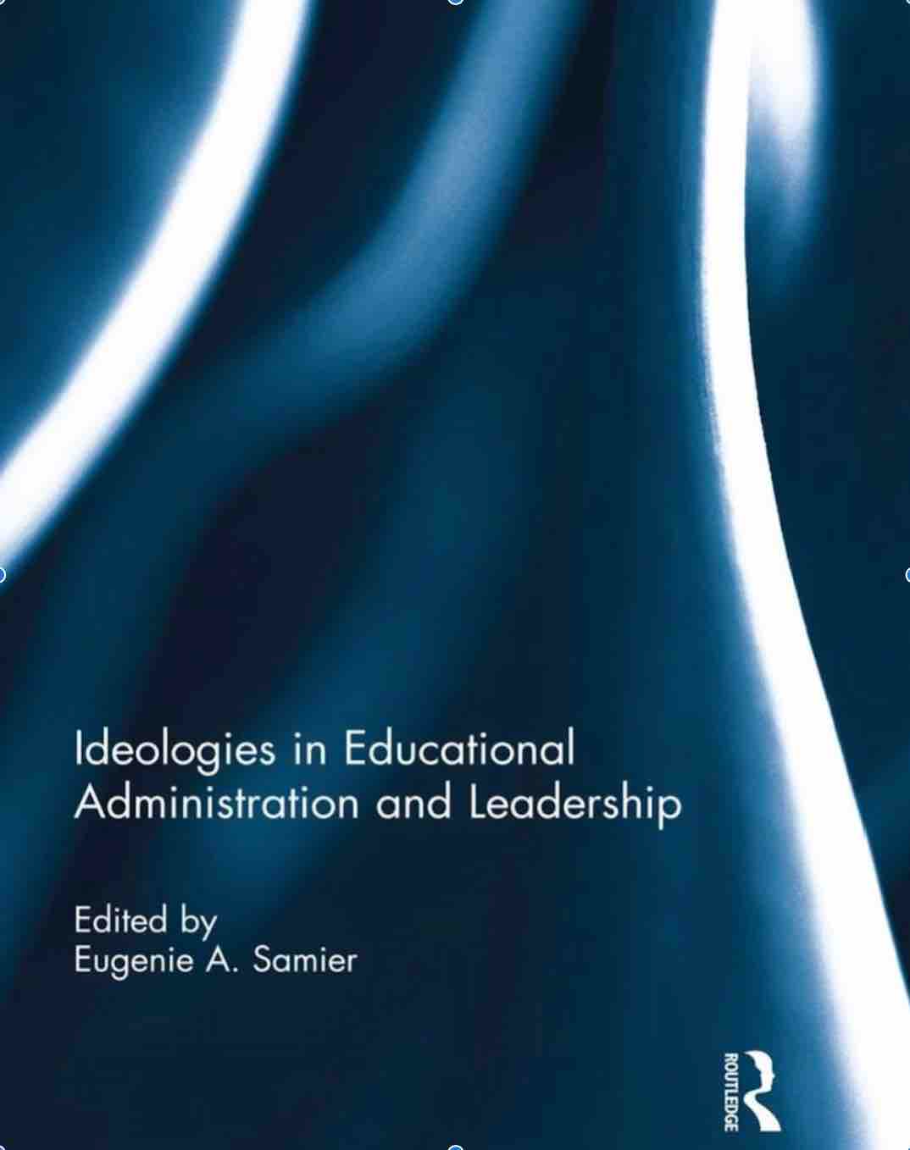
A Foucauldian perspective on regime of truth and governmental dispositifs such as educational leadership then let us go beyond ideological petitions and presumptions.
THANK YOU
this presentation derives from the chapter “Discourses and contexts of educational leadership. From ideology to dispositif” in Samier, E. (2016)

